Slide 1
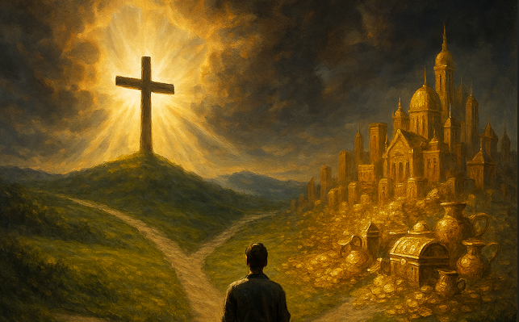
The Unparalleled Value That ALL MIGHTY GOD Has Placed on Every Human Soul
Matthew 16:24-27

Slide 2
Matthew 16:24-27 (KJV)
²⁴ Then said Jesus unto his disciples, If any man will come after me, let him deny himself, and take up his cross, and follow me. ²⁵ For whosoever will save his life shall lose it:

Slide 3
Matthew 16:24-27 (KJV)
and whosoever will lose his life for my sake shall find it. ²⁶ For what is a man profited, if he shall gain the whole world, and lose his own soul? or what shall a man give in exchange for his soul?

Slide 4
Matthew 16:24-27 (KJV)
²⁷ For the Son of man shall come in the glory of his Father with his angels; and then he shall reward every man according to his works.

Slide 5
Matthew 16:26 commentary from a Greek perspective highlights the meaning of psyche (ψυχή), which is translated as "soul" but also means "life," emphasizing the eternal value of a person's spiritual essence over worldly gain.

Slide 6
The verse uses the Greek verbs ōp, the unparalleled value All Mighty GOD has placed on every human soul.
AND
heleō (to profit) and kerdainō (to gain), contrasting the temporary gains of the world with the permanent loss of the soul.

Slide 7
The second question uses the verb didōmi (to give) to stress that there is no earthly equivalent or "exchange" that can redeem the soul once it is lost.

Slide 8
Man is composed of Body, Soul, and Spirit - I Thessalonians 5:23
And the very God of peace sanctify you wholly; and I pray God your whole spirit and soul and body be preserved blameless unto the coming of our Lord Jesus Christ.

Slide 9
Body, soul, and spirit are three components of a person, according to some religious viewpoints, especially Christianity. The body is the physical form, the soul is the seat of emotions, personality, will, and mind, and the is the innermost part of a person that connects to God.

Slide 10
Body:
This is the physical, material part of a person, including organs, muscles, and bones. It is the external "house" through which a person experiences the natural world.

Slide 11
SOUL:
The soul is often described as the "self" or the essence of a person's being. It encompasses the mind, will, and emotions, and is the source of personality, reasoning, and decision-making. It is considered the neutral ground between the body and the spirit.

Slide 12
Spirit:
The spirit is typically seen as the innermost, immaterial part of a person. It is considered the part that connects with God and is the source of a person's identity and purpose.

Slide 13
Key Differences and Connections:
Interaction
Function
Mortality
Intertwined Nature

Slide 14
Interaction:
The body perceives the physical world, the soul the psychological realm, and the spirit the spiritual realm.

Slide 15
Function:
The body is the vessel, the soul is the "self" or personality, and the spirit is the point of connection to the divine.

Slide 16
Mortality:
While the body is mortal and returns to dust, the soul and spirit are generally considered eternal, continuing to exist after physical death.

Slide 17
Intertwined Nature:
All three are deeply connected. A person's spiritual health can impact their emotional (soul) and physical (body) health. The goal in many spiritual practices is to align all three parts harmoniously.

Slide 18
The True Story of the Rich Man and Lazarus
Luke 16:19-31 (NAS)

Slide 19
Luke 16:19-31 (NAS)
¹⁹ "Now there was a rich man, and he habitually dressed in purple and fine linen, enjoying himself in splendor every day.
²⁰ "And a poor man named Lazarus was laid at his gate, covered with sores,

Slide 20
Luke 16:19-31 (NAS)
²¹ and longing to be fed from the scraps which fell from the rich man's table; not only that, the dogs also were coming and licking his sores. ²² "Now it happened that the poor man died and was carried away by the angels to Abraham's arms;

Slide 21
Luke 16:19-31 (NAS)
and the rich man also died and was buried.
²³ "And in Hades he raised his eyes, being in torment, and saw Abraham far away and Lazarus in his arms.

Slide 22
Luke 16:19-31 (NAS)
²⁴ "And he cried out and said, 'Father Abraham, have mercy on me and send Lazarus, so that he may dip the tip of his finger in water and cool off my tongue, for I am in agony in this flame.'

Slide 23
Luke 16:19-31 (NAS)
²⁵ "But Abraham said, 'Child, remember that during your life you received your good things, and likewise Lazarus bad things; but now he is being comforted here, and you are in agony.

Slide 24
Luke 16:19-31 (NAS)
²⁶ 'And besides all this, between us and you a great chasm has been set, so that those who want to go over from here to you will not be able, nor will any people cross over from there to us.'

Slide 25
Luke 16:19-31 (NAS)
²⁷ "And he said, 'Then I request of you, father, that you send him to my father's house— ²⁸ for I have five brothers—in order that he may warn them, so that they will not come to this place of torment as well.'

Slide 26
Luke 16:19-31 (NAS)
²⁹ "But Abraham said, ‘They have Moses and the Prophets; let them hear them.’ ³⁰ "But he said, 'No, father Abraham, but if someone goes to them from the dead, they will repent!'

Slide 27
Luke 16:19-31 (NAS)
³¹ "But he said to him, 'If they do not listen to Moses and the Prophets, they will not be persuaded even if someone rises from the dead.'"

Slide 28
The question "What shall a man give in exchange for his soul?" is a philosophical and theological query that primarily originates from the New Testament of the Christian Bible. The most common source is the Gospel of Mark, which states:

Slide 29
"For what does it profit a man to gain the whole world and forfeit his soul? For what can a man give in return for his soul?"
Mark 8:36–37 (ESV) In This Context, the Scripture Implies That:

Slide 30
1: The Soul is Invaluable:
The value of the human soul is depicted as being greater than all the material wealth and worldly success a person could possibly attain.

Slide 31
2. Worldly Gain is Temporary:
Gaining the "whole world" (power, riches, fame) is ultimately fleeting and cannot provide eternal salvation or true fulfillment if it results in the loss or corruption of one's inner self or spiritual life.

Slide 32
3. No Exchange is Possible:
The rhetorical question suggests that there is nothing of equal or greater value that can be offered as a substitute for one's eternal self.

Slide 33

PLEASE PLEASE PLEASE DON’T LOSE YOUR SOUL

Slide 34

…that Christ died for our sins according to the scriptures; And that he was buried, and that he rose again the third day according to the scriptures:

Slide 35
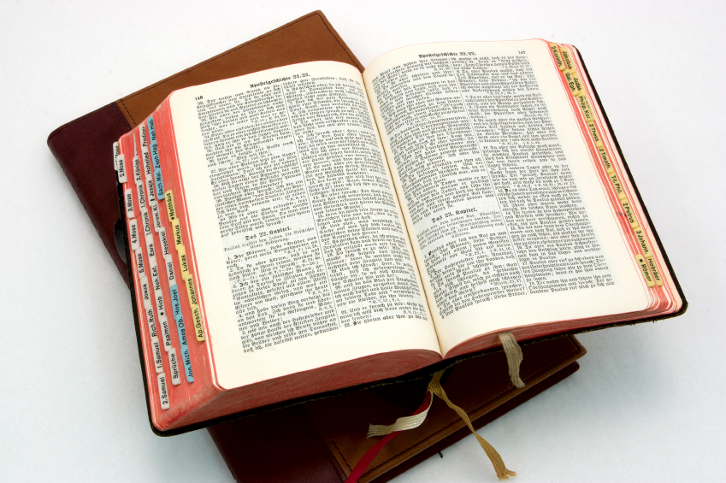
Hear: Romans 10:17
So then faith cometh by hearing, and hearing by the word of God.

Slide 36
Believe: Hebrews 11:6
But without faith it is impossible to please him: for he that cometh to God must believe that he is, and that he is a rewarder of them that diligently seek him.

Slide 37
Repent: Luke 13:3
I tell you, Nay: but, except ye repent, ye shall all likewise perish.

Slide 38
Confess: Matthew 10:32-33
32 Whosoever therefore shall confess me before men, him will I confess also before my Father which is in heaven.
33 But whosoever shall deny me before men, him will I also deny before my Father which is in heaven.

Slide 39
Baptize: Acts 22:16
And now why tarriest thou? arise, and be baptized, and wash away thy sins, calling on the name of the Lord.

